Slide 1
Summary
Bivariate models were fitted across all the predictors with linear regressions for numeric outcome variable AF and logistic regression for the binary outcome variable PR
Age and treatment have a significant relationship on AF
Age was the only significant predictor of PR
Genetic SNPs did not have any significant effect with the current basic model
No data for smoking status – all non-smokers
Would need a combination of smokers and non-smokers to determine a relationship

Slide 2
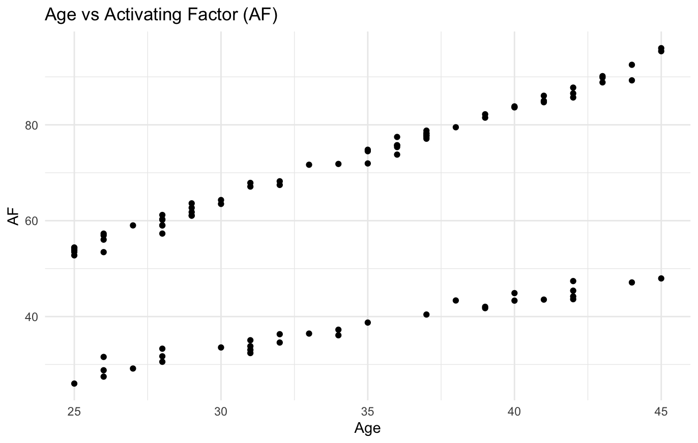
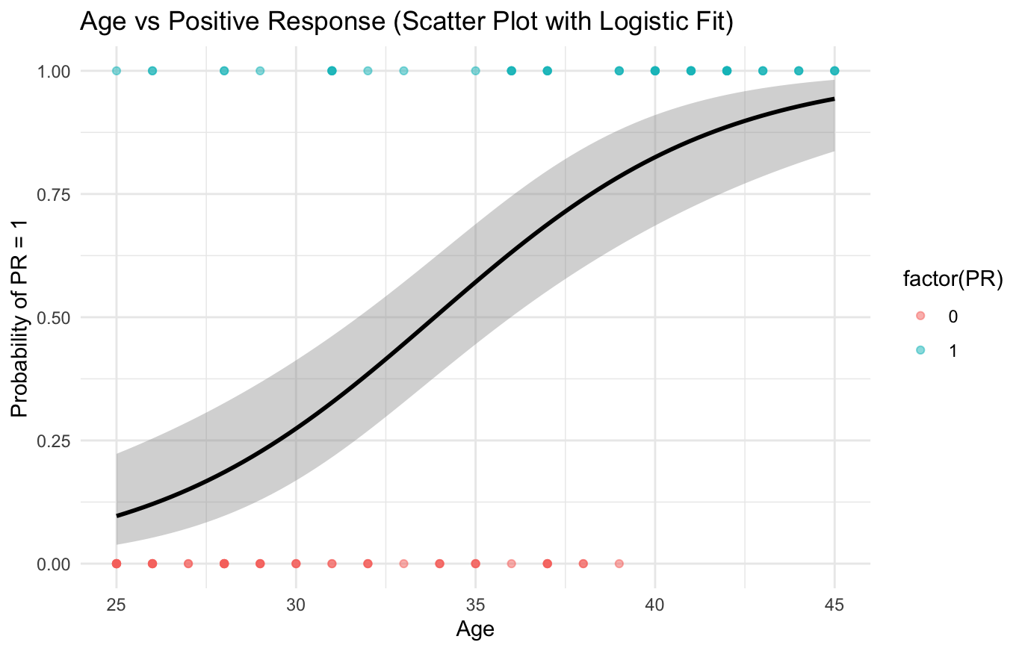
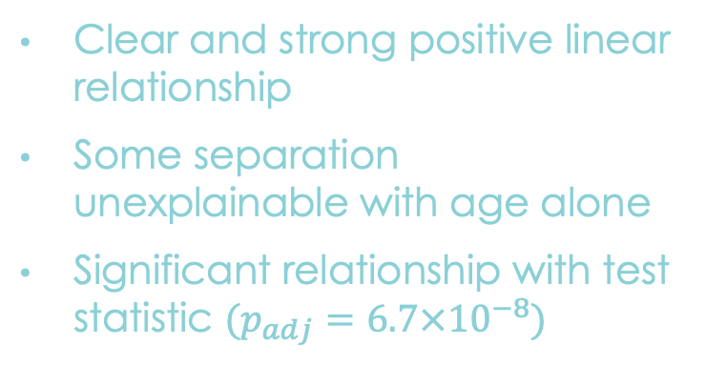
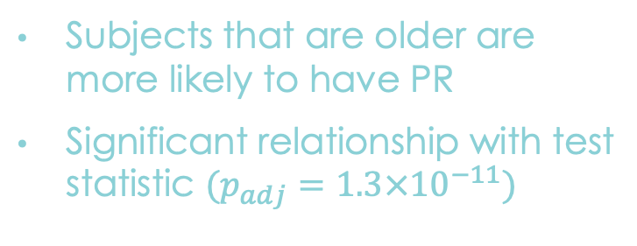
Age Effect
Clear and strong positive linear relationship
Some separation unexplainable with age alone
Significant relationship with test statistic $(p_{adj}=6.7×{10}^{−8})$
Subjects that are older are more likely to have PR
Significant relationship with test statistic $(p_{adj}=1.3×{10}^{−11})$

Slide 3
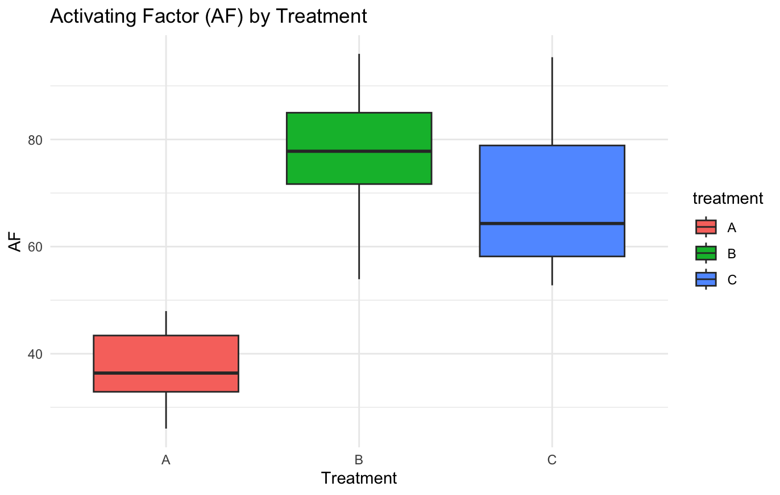
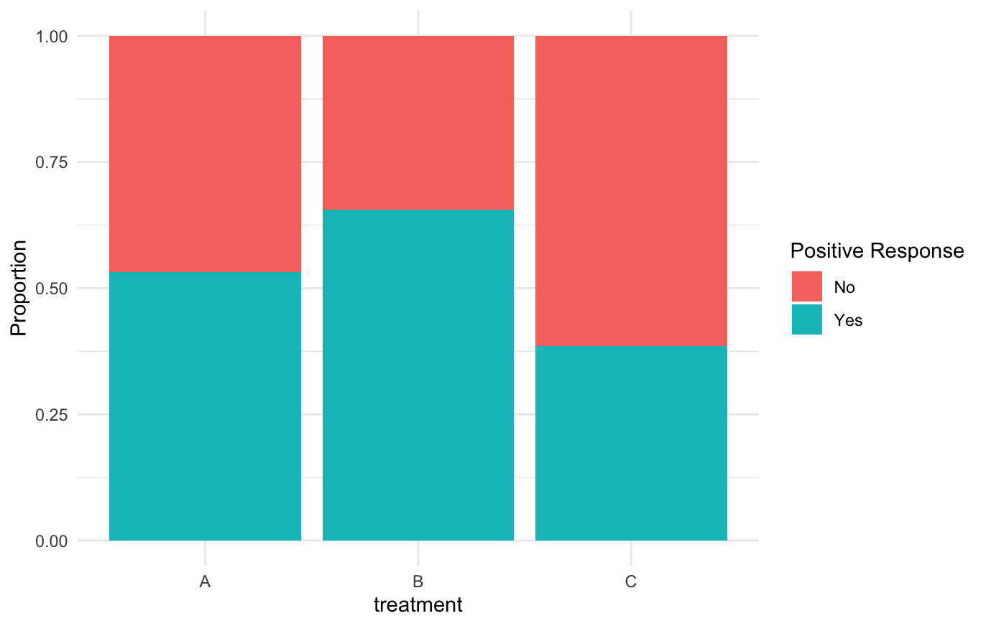
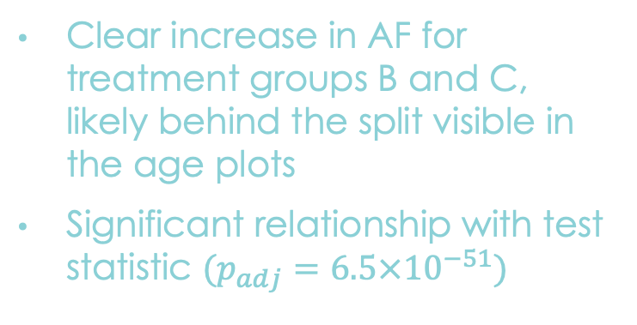
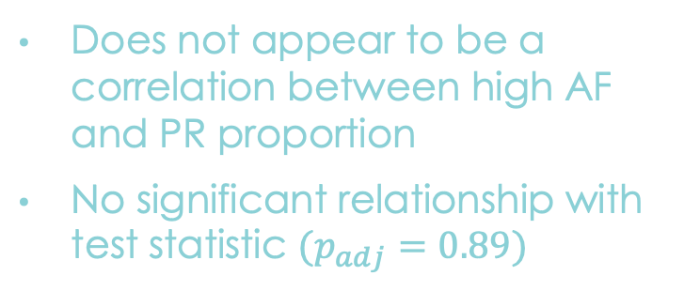
Treatment Effect
Clear increase in AF for treatment groups B and C, likely behind the split visible in the age plots
Significant relationship with test statistic $(p_{adj}=6.5×{10}^{−51})$
Does not appear to be a correlation between high AF and PR proportion
No significant relationship with test statistic $(p_{adj}=0.89)$

Slide 4
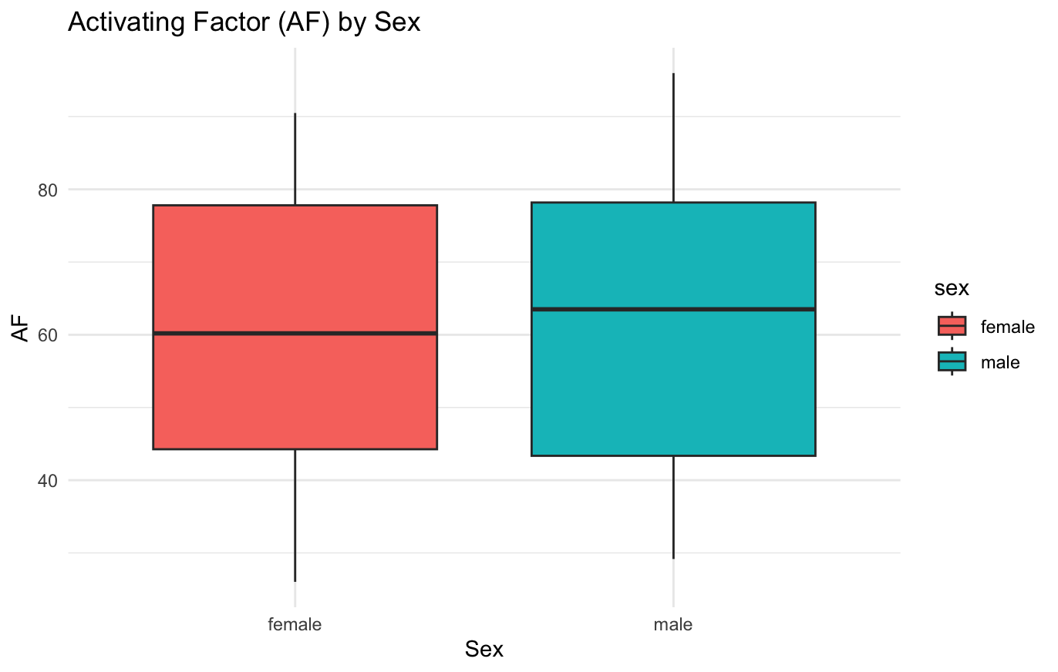
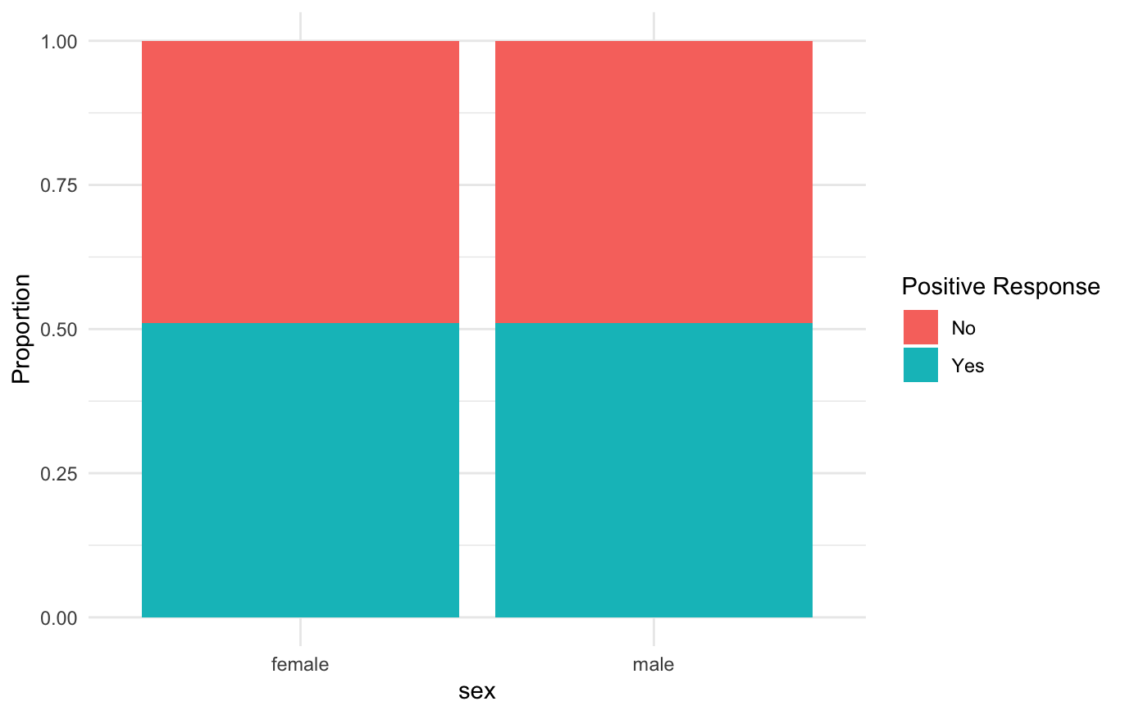


Sex Effect
There is no significant relationship between sex and either AF or PR
Test statistic $(p_{adj}=0.98)$
Test statistic $(p_{adj}=0.99)$

